Slide 1
Machine Learning Using Python (Scikit Learn) an Introduction
Girish Gore

Slide 2
Introducing the Speaker
Girish Gore : 10+ Years of Experience in Data Analytics / Data Science
M.S. (Data Mining and Applications) from BITS Pilani
B.E. Computer Science from VIT Pune
Spent Time on Data Products Mainly In companies like
Cognizant (Innovations Group)
SAS (Pricing & Revenue Management)
VuClip (Video Entertainment)
Shoptimize (E-Commerce)
Worked in fields like
Dynamic Pricing ,Forecasting and Optimization
Recommender Systems
Business Metric Generation

Slide 3
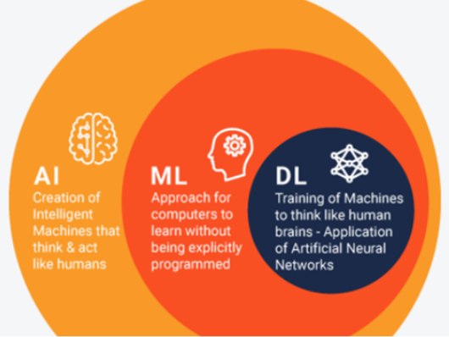
The Hierarchy

Slide 4
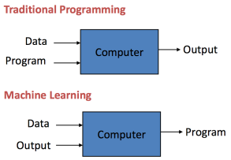
Traditional Programming vs Machine Learning
If Programming automates processes ,
Machine Learning automates Program
generation i.e. Automation.
Data and output is run on the computer to
create a program. This program can be used
in traditional programming

Slide 5
Types Of Machine Learning
Learning Associations
Supervised Learning
Regression
Classification
Un Supervised Learning
Reinforcement Learning
Semi supervised Learning
Training data includes a few desired outputs. Between supervised and un supervised

Slide 6
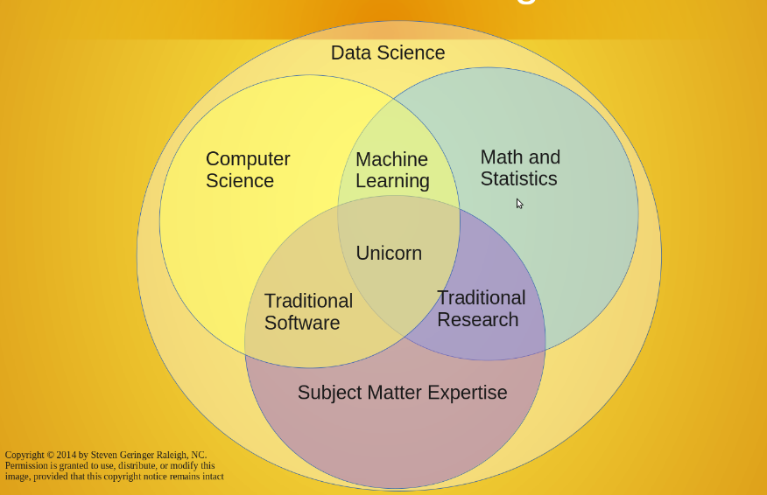
ML – Data Science Relationship

Slide 7
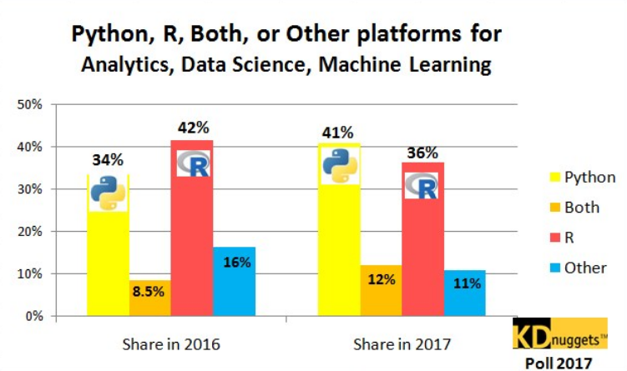
Python For Data Science
Easy to Learn
Easy to Understand Syntax
Short Learning Curve
Scalability
Rapid adoption & Dev
Leaner & Faster
Choice of Data Science
Libraries
Python Community
Vibrant Community of
Vibrant programmers

Slide 8
Scikit Learn
It's an extensive, well-documented, and accessible, curated library of machine-learning models
It is built upon Scipy library which includes following primary libraries
SciPy: Fundamental library for scientific computing
NumPy: Base n-dimensional array package
Matplotlib: Comprehensive 2D/3D plotting
IPython: Enhanced interactive console
Sympy: Symbolic mathematics
Pandas: Data structures and analysis
Seaborn : Visualization library based on matplotlib
Numpy provides a high-performance multidimensional array and basic tools to compute with and manipulate these arrays. SciPy builds on this, and provides a large number of functions that operate on numpy arrays and are useful for different types of scientific and engineering applications.

Slide 9
Pros & Cons of Using Scikit learn
Consistent Interface for Machine Learning Models
Provides multiple tunining parameters with sensible defaults
Exceptional Documentation
Rich set of functionality support
Active support and development
Potential Cons …
Steep learning curve than R
Machine Learning centric approach makes Interpretability difficult than R
More Readings :
https://www.oreilly.com/ideas/six-reasons-why-i-recommend-scikit-learn

Slide 10
Steps in Machine Learning
Gathering data : Related , Connected , Accurate , Enough
EDA : Exploratory Data Analysis
Explore Features as Continues , Categorical , Ordinal & their distributions
Visualizing their relation with each other ; with the dependent variable
Pre Processing the Data
Feature Generation
Feature Elimination
Feature Transformation
Continues Variables : Center , Scale , Box Cox
Categorical Variable : Label Encoding ; One Hot Encoding
Choosing the right algorithm / model
Over fitting vs. Under fitting : Test / Train Split Strategies
Evaluation
Hyper parameter tuning
Prediction

Slide 11
A Scikit Learn applied example

Slide 12
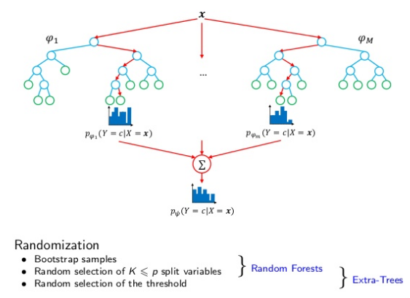
RandomForest (Recap)
Random forests include three main tuning parameters:
Node Size: unlike in decision trees, the number of observations in the terminal nodes of each tree of the forest can be very small. The goal is to grow trees with as little bias as possible.
Number of Trees: in practice, 500 trees is often a good choice.
Number of Predictors Sampled: the number of predictors sampled at each split would seem to be a key tuning parameter that should affect how well random forests perform. Sampling 2-5 each time is often adequate.

Slide 13
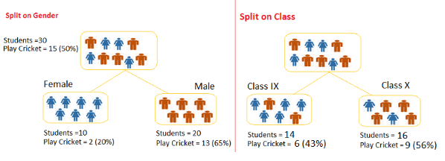
Gini Index (Recap)
Split on Gender:
Calculate, Gini for sub-node Female = (0.2)*(0.2)+(0.8)*(0.8)=0.68
Gini for sub-node Male = (0.65)*(0.65)+(0.35)*(0.35)=0.55
Calculate weighted Gini for Split Gender = (10/30)*0.68+(20/30)*0.55 = 0.59
Similar for Split on Class:
Gini for sub-node Class IX = (0.43)*(0.43)+(0.57)*(0.57)=0.51
Gini for sub-node Class X = (0.56)*(0.56)+(0.44)*(0.44)=0.51
Calculate weighted Gini for Split Class = (14/30)*0.51+(16/30)*0.51 = 0.51

Slide 14
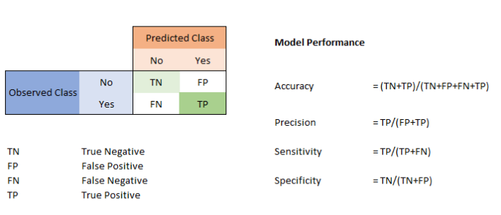
Confusion Matrix
Sensitivity = Recall = True Positive Rate
Specificity = Precision = True Negative Rate
1 – Specificity = False Positive Rate = FP / (TN + FP)

